Slide 1
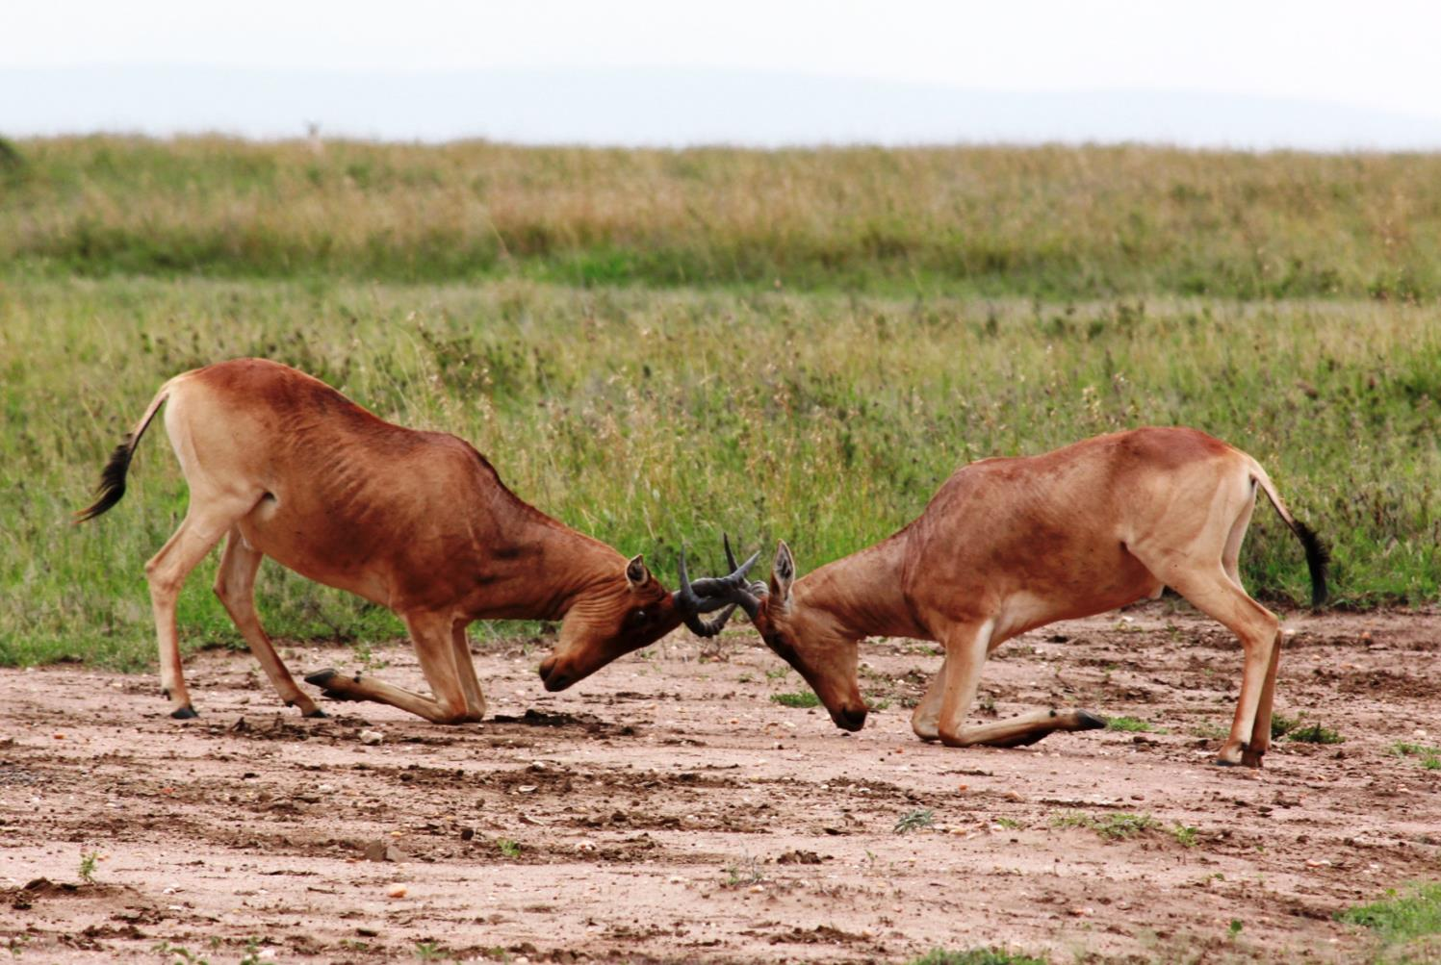
Ecology of Individuals: Using Game Theory to Understand Animal Behavior
by
Kyla M. Flanagan Department of Biological Sciences University of Calgary, Alberta, Canada

Slide 2
Objectives
By the end of this lecture, you should be able to:
Explain what game theory is and how/why it is applied to ecology.
Explain how novel behavioral strategies can invade a population.
Explain evolutionarily stable strategy (ESS) and frequency dependent selection.
Describe why natural selection acts on relative fitness and how this fitness can depend on the frequency of other “types” of individuals in the population.
Explain how coexistence of multiple behavioural strategies in a population is possible.

Slide 3
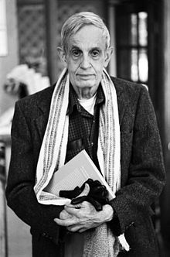
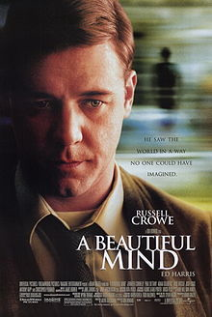
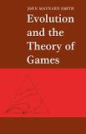
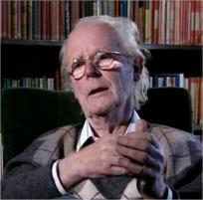
Game Theory
Game Theory is “a branch of mathematics devoted to the study of strategy in which players seek to maximize their individual returns” (Molles and Cahill).
Forms the basis of many economic theories, war strategy, sociological theories (and board games!)
John Maynard Smith emphasized the potential for its use in behavioral ecology
John Nash
John Maynard Smith

Slide 4
Game Theory
What behavioral strategy should individuals adopt to maximize their individual fitness? Does the “best” strategy depend on the strategy of other individuals?
Should individuals behave aggressively and fight for resources or behave non-aggressively?

Slide 5
The Big Question
Use evidence from this case study to answer the following:
If natural selection is “survival of the fittest,” then under what conditions should individuals engage aggressively in conflict for limited resources? Can aggressive and non-aggressive strategies coexist?
Notes:
“BIG QUESTION”

Slide 6
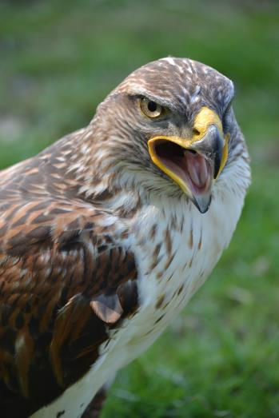
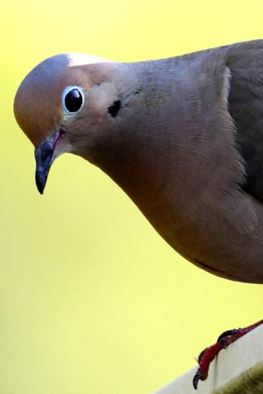
Hawk vs. Dove Game
2 behavioral approaches for interactions over a contested resource:
Hawks
Doves

Slide 7
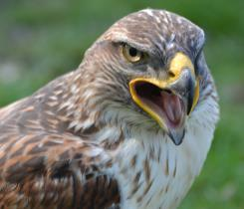
The Rules: Hawks
Always attack other individuals, taking the resource (R) if they win.
If a hawk encounters another hawk, it will win only half the time.
When it loses, it will suffer an injury cost (C).
AGRESSIVE

Slide 8
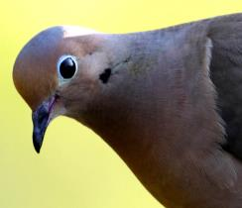
The Rules: Doves
When a dove encounters an opponent, it may put on a aggressive display, but it does NOT fight.
When a dove encounters a dove, it will win the resource one half the time.
When a dove encounters a hawk, the hawk will always win the resource.
But since they don’t fight, they don’t incur any injury costs (C).
NON-AGRESSIVE

Slide 9
Which behavioral strategy wins?
Hawks vs. Doves?
Is there an optimal behavioral strategy?
Will hawks take over?
Will doves be able to persist?

Slide 10
Clicker Question 1
Which behavioral strategy do you think will “win”?
Hawks
Doves
Both
Neither

Slide 11
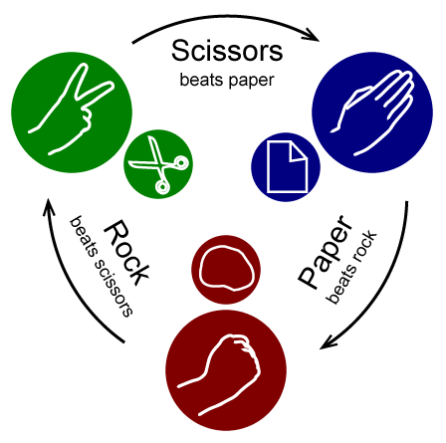
Hawk Fitness
You are all HAWKS
Compete for resource! GO!
Notes:
The first behaviour the students will explore is the Hawks. At this point you will need to explain the “rules.” Everyone in the class is going to be a Hawk. They are going to compete over the 4 resource cards they hold in their hands. These resource cards are going to be used as a surrogate measure of FITNESS. The more resources an individual has, the more likely it is to survive and reproduce. To compete for the resource, they are going to turn to their neighbour and “fight” using ROCK-PAPER-SCISSORS. The winner takes ONE RESOURCE card from the loser. The loser, because hawks fight aggressively over the resource, suffers an injury cost. So, the loser must put TWO RESOURCE cards in his/her back pocket (these are lost and can’t be used again).
Ask everyone to have TWO INTERACTIONS (COMPETITIONS) for the resources. This must be exactly 2 interactions, no more, no less.

Slide 12
Clicker Question 2
How many resource cards do you hold in your hand?
0
1
2
3
4
5
6

Slide 13
Vulnerability to Invasion - Hawks
Do you predict that a DOVE can invade a population of HAWKS?
Now, let’s see if a DOVE can invade the population.
Notes:
Select a student (ideally someone you know won’t be embarrassed!). Tell the students that this individual has a random mutation that causes them to adopt a DOVE behavioural strategy. You may have to remind them of the rules that when a hawk and dove interact, the hawk always wins and just takes the resource.
Let the Dove try to “invade” the population of hawks. What you should see is that the dove loses a resource card for each interaction and that after 4 interactions the dove is left with no resources. Then ask: Can a dove invade a population of hawks? NO!
You could ask the first question as a clicker question, if you have the time.

Slide 14
Evolutionarily Stable Strategy (ESS)
ESS: “a behavioural strategy that is resistant to invasion and most likely to be maintained by natural selection” (Molles and Cahill 2013).
Is a Hawk an ESS? A Dove?
Do you think Hawks will take over the behavioral strategy of the population of Doves?

Slide 15
Dove Fitness
Now you are all DOVES
Compete for resources, GO!
Notes:
Now because the doves do not fight aggressively, they do not suffer injury costs. When they compete over resources (using Rock-paper-scissors), 50% of the time they win and 50% of the time they lose. Ask the student to again have TWO interactions over a resource.

Slide 16
Clicker Question 3
How many resource cards do you hold in your hand?
0
1
2
3
4
5
6

Slide 17
Vulnerability to Invasion - Doves
Do you predict that a Hawk can invade a population of Doves?
Now let’s see if a HAWK can invade a population of DOVES?
Notes:
? I like to call on a TA to do this, for their very hawk-likeness as a TA. Now the TA Hawk enters the population of Doves. Because the hawk always wins against a dove, it just takes a resource from each dove and rapidly gets resources. Ask: Can the hawk strategy invade the population of individuals with a dove strategy? YES!
You could ask the first question as a clicker question, if you have the time.

Slide 18
Hawks vs. Doves
OK, now we are going to start with ~10% of the population being Hawks, and ~90% Doves and track what happens to this ratio over time.
NOW Hawks and Doves can reproduce!
If you lose all your resource cards, sit down.
If you get 8 resource cards, you find someone sitting down and convert them to whatever you are by giving them 4 cards!
Notes:
. If a Hawk and Hawk compete over a resource, they do Rock-Paper-Scissors to fight over the resource. The loser gives one resource card to the winner and loses (into the back pocket) 2 resource cards for injury cost, just like before. When a Hawk encounters a Dove, it always wins the competition, and doesn’t sustain an injury cost. When two Doves interact, they do Rock-Paper-Scissors over the resource, and sustain no injury cost. When students approach each other, they need to tell each other what they are (Hawk or Dove) and then proceed.
Now if an individual loses all the resources in their hand, they are ‘dead’ and must sit down.
If an individual has 8 resources cards in their hand, they must reproduce by giving someone who is sitting down 4 resource cards and telling that individual whether they are now a hawk or a dove.
For this to work, you will need a TA to be a ‘decomposer’. This person will approach dead individuals and ask them for any resources they have in their back-pocket. If they retrieve cards, they should give them out randomly to those individuals that are still alive. Without the decomposers resources end up bound in the back pockets of individuals and there is a constant loss of resources from the ‘system’. Redistributing these resources when an individual has died mimics nature.
By allowing individuals to ‘die’ and ‘reproduce’ you can now see that the proportion of individuals in the class that are hawks and doves evolve.

Slide 19
Clicker Question 4
Are you currently a hawk or a dove?
Hawk
Dove
Notes:
This question will need to be asked multiple times every few minutes to watch the frequency of hawks and doves evolve.

Slide 20
Simple versus frequency-dependent selection
In this case, an individual’s fitness DEPENDS on the behavior (and the frequency of the behavior) of OTHERS.
Is there a single optimal behavioral strategy in this case?

Slide 21
Frequency dependent selection
Frequency dependent selection occurs when the fitness of an individual depends on the relative frequency of other phenotypes in the population.
Positive frequency dependent selection – majority advantage (majority phenotype wins).
Negative frequency dependent selection – minority advantage. Promotes genotypic and phenotypic diversity. Some combination of phenotype.
Frequencies may exist at which all phenotypes have the same fitness.

Slide 22
The Big Question Revisited
Use evidence from this case study to answer the following:
If natural selection is “survival of the fittest,” then under what conditions should individuals engage aggressively in conflict for limited resources? Can aggressive and non-aggressive strategies coexist?
Notes:
“BIG QUESTION”

Slide 23
Hawk-Dove
Relative frequency of Hawks = p
Relative frequency of Doves = 1-p
Average payoff for Hawk = p∙(0.5∙R - 0.5∙C) + (1 - p)(R)
Average payoff for Dove = p ∙ 0 + (1-p) ∙ (0.5∙R)

Slide 24
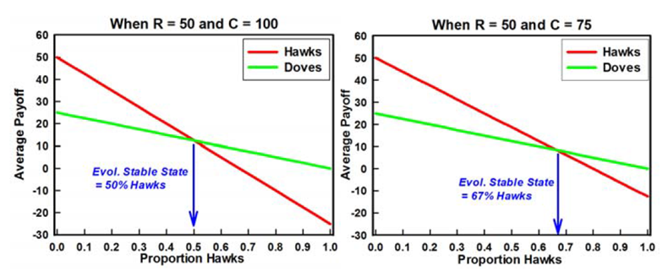
Frequency dependent selection

Slide 25
Image Credits
Slide 1:
Description: Photo of fighting Hartebeest
Source: Fickr user Filip Lachowski, http://www.flickr.com/photos/malczyk/5638599313/
Clearance: Attribution-ShareAlike 2.0 Generic (CC BY-SA 2.0), https://creativecommons.org/licenses/by-sa/2.0/
Slide 3:
John Nash (top left): http://en.wikipedia.org/wiki/John_Forbes_Nash,_Jr.
A beautiful mind poster (top right): http://en.wikipedia.org/wiki/A_Beautiful_Mind_(film)
Evolution and the Theory of Games (bottom left): http://books.google.ca/books/about/Evolution_and_the_Theory_of_Games.html?id=Nag2IhmPS3gC&redir_esc=y
John Maynard Smith (bottom right): http://commons.wikimedia.org/wiki/File:John_Maynard_Smith.jpg
Slides 6, 8, and 15:
Description: Photo of mourning dove.
Source: Modified (horizonatal flip and crop) from a photo by Flickr user Dawn Huczek, https://www.flickr.com/photos/31064702@N05/4821595992
Clearance: Attribution 2.0 Generic (CC BY 2.0), https://creativecommons.org/licenses/by/2.0/
Slides 6, 7, and 11:
Description: Photo of hawk (Buteo regalis)
Source: Flickr user Tim Strater, http://www.flickr.com/photos/41601691@N02/5665779491
Clearance: Attribution-ShareAlike 2.0 Generic (CC BY-SA 2.0), https://creativecommons.org/licenses/by-sa/2.0/
Slides 11 and 15:
Description: Diagram of rules for Rock, Paper, Scissors
Source: By Wikimedia Commons user Enzoklop, http://commons.wikimedia.org/wiki/File:Rock-paper-scissors.svg
Clearance: Attribution-ShareAlike 3.0 Unported (CC BY-SA 3.0), http://creativecommons.org/licenses/by-sa/3.0/deed.en
Slides 24:
Description: Graphs showing frequency dependent selection.
Source: By Ross Lein.
Clearance: Used with permission.

